Slide 1
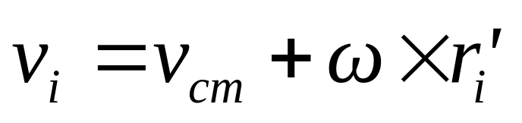
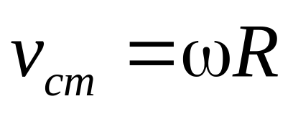
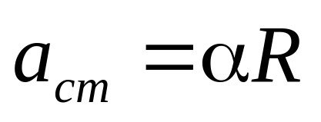
Combined rotational and translational motion
Σ F_{ext}=ma_{cm}
ω
v_{cm}
Σ τ_{ext}= Iα
B
B
Plane parallel motion
Rolling without slipping
About B point
Instantaneous axis

Slide 2
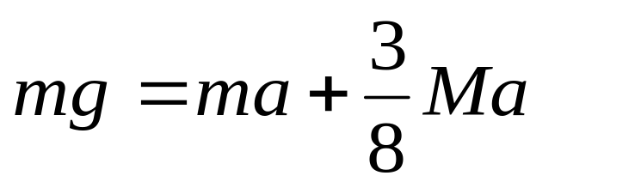
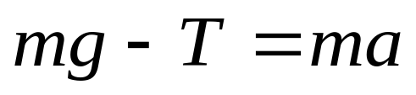
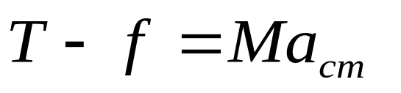

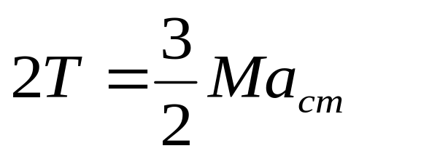
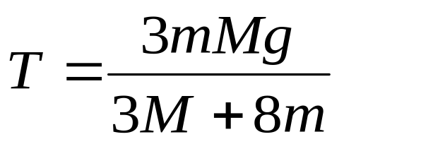
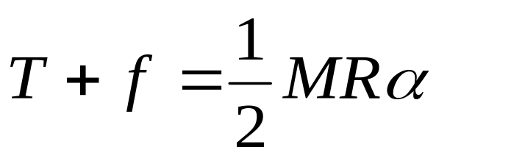
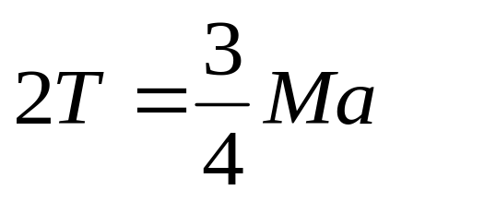
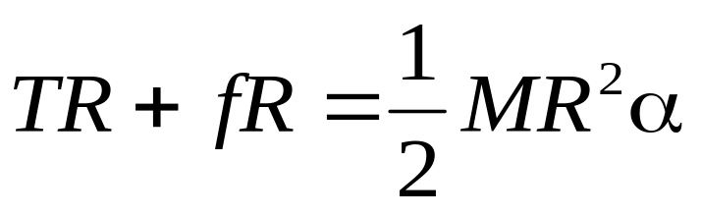
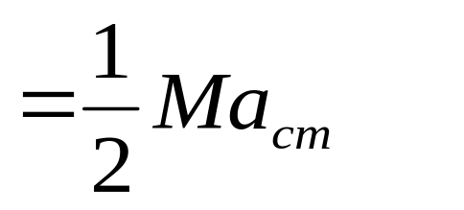
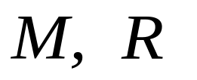
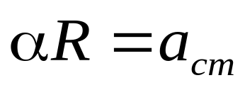
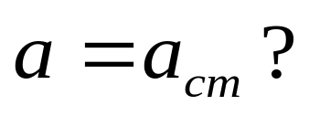

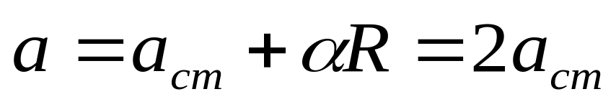

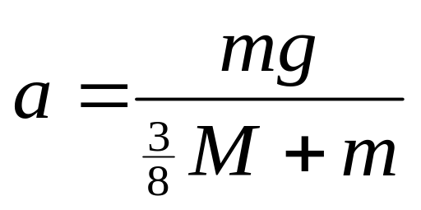


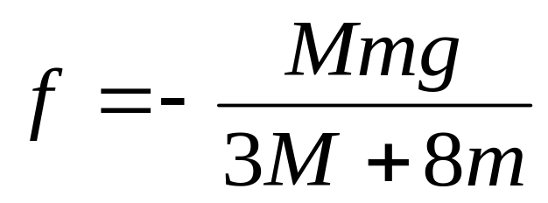
Example
ω₀
Rolling without slipping
a = ?, f = ?

Slide 3

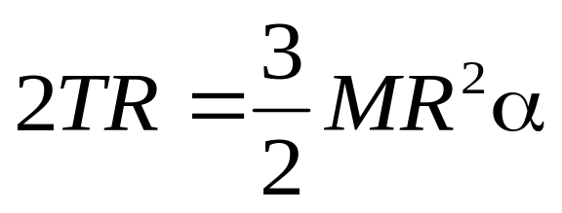
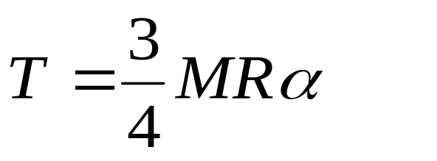
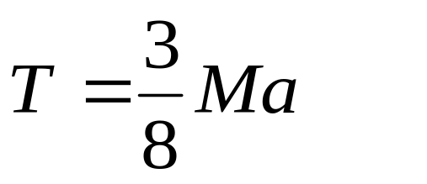


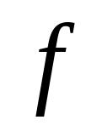
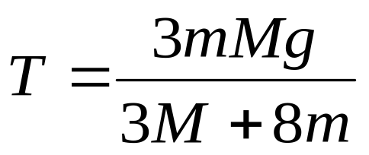
Example
ω₀
Rolling without slipping

Slide 4
Example
A uniform solid cylinder of radius R and mass M is given an initial (clockwise) angular velocity ω₀ and then lowdown to a uniform horizontal surface.
ω₀
f
The coefficient of kinetic friction between the surface and the cylinder is μ_{k}.
Rolling with slipping
Initially the cylinder slips as it moves along the surface, but after a time t, pure rolling without slipping begins.
What is the velocity v_{cm} of the center of mass at the time t and what is the value of t?

Slide 5
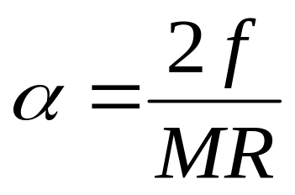
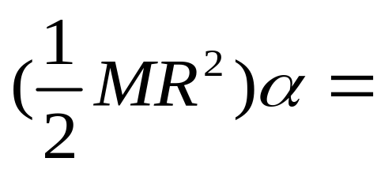
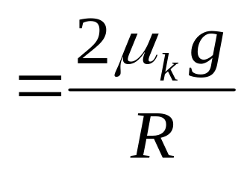
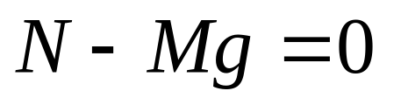
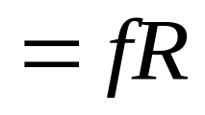

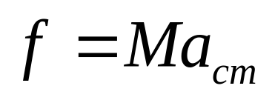
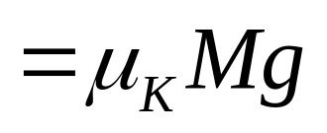
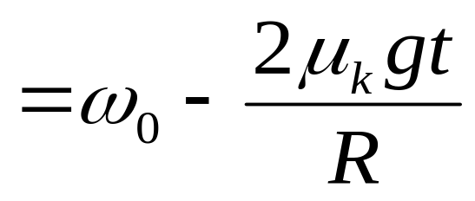
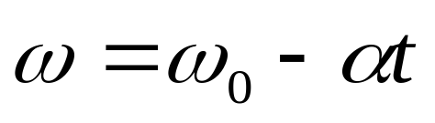
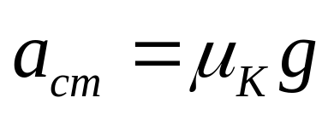
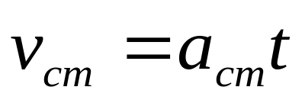
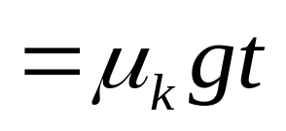
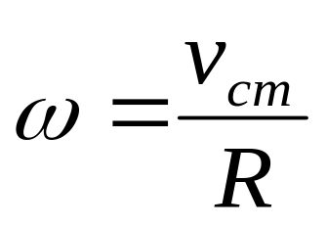
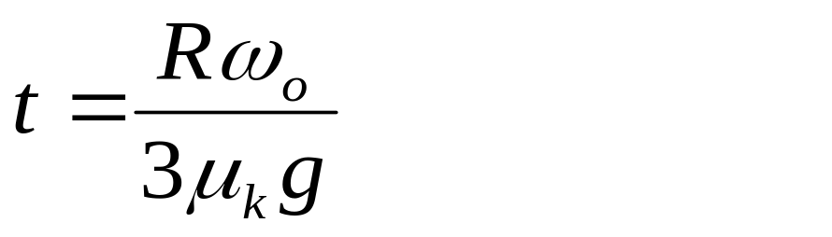
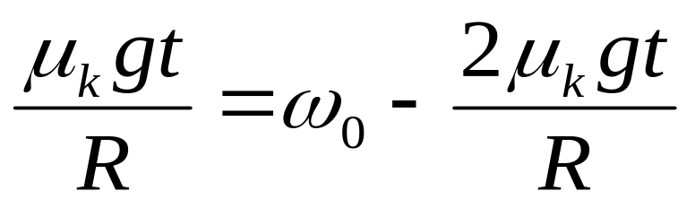
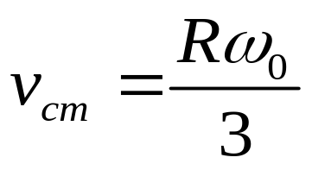
Example
A uniform solid cylinder of radius R and mass M is given an initial (clockwise) angular velocity ω₀ and then lowdown to a uniform horizontal surface.
ω₀
f
The coefficient of kinetic friction between the surface and the cylinder is μ_{k}.
Rolling with slipping
After the time t, the rotation without slipping begins.

Slide 6
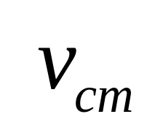
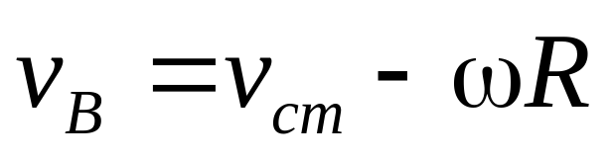
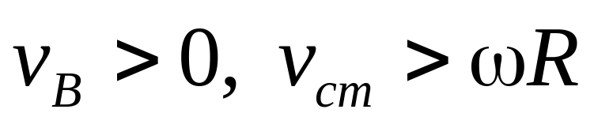
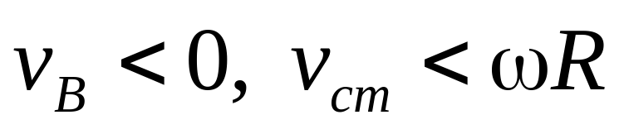
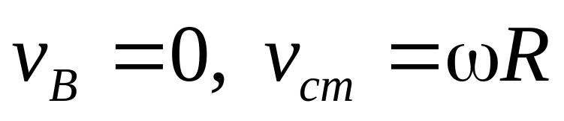
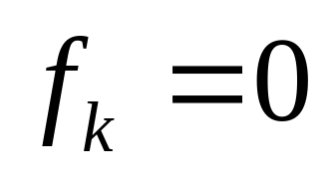
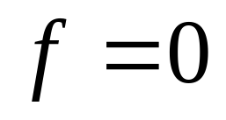
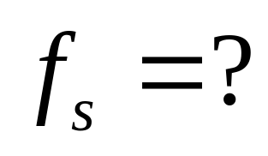
The direction of frictional force in rolling

Slide 7
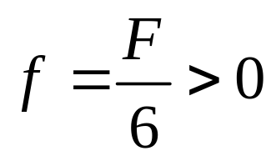
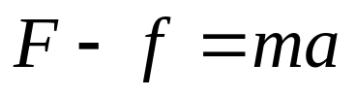
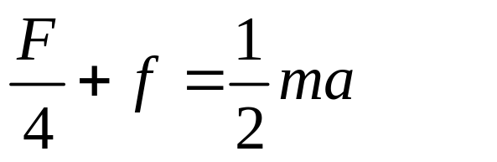








If the force F act on the point R/4 from the center, and rotation without slipping
Example
F
f
F
f

Slide 8








If the force F act on the point R/4 from the center, and rotation without slipping
Example
F
f
f
F
F
F
f
f

Slide 9
Chapter 10
Angular Momentum

Slide 10












Angular momentum of a particle
The angular momentum respect to O
Angular momentum
linear momentum

Slide 11




Angular momentum of a particle
The angular momentum respect to O
Angular momentum
linear momentum
Both τ and l must be respect to the same origin.

Slide 12






Impulse and momentum
Angular impulse and angular momentum
If Στ=0, thus l_{f}=l_{i}, the angular momentum is not changed.
Both τ and l must be
respect to the same origin.

Slide 13



















Example:
A
r
Find the torque of T and mg, total torque, angular momentum respet to point O
θ
A
T
τ_{T} τ_{mg} τ_{T+mg} l
R
o
mg
the τ and l are different with the different origin point;
the angular momentum with point A is not a constant vector, but the angular momentum with point O is conservation.

Slide 14



























Angular momentum and angular velocity
A particle of mass m rotate about z axis with angular velocity ω.
l
The tangential speed is v=ωr´.
direction of l is not same as ω.
direction of l_{z} is same as ω.

Slide 15






Angular momentum and angular velocity
A particle of mass m rotate about z axis with angular velocity ω. The tangential speed is v=ωr´.
τ =?

Slide 16






Angular momentum and angular velocity
dl⊥
l⊥
l⊥
dφ
τ
τ
τ =?

Slide 17
CHAP. 9 problems
21, 22, 24 (P206)
CHAP. 10 exercises
1, 3 (P224)

Slide 18













Angular momentum and angular velocity
Its angular momentum respect to O is:
l⊥
The l_{z} is remains constant in both magnitude and direction. The l⊥ changes its direction. This change in l⊥
Σ l⊥=0

Slide 19






L
Two particles
l₁
l₂
If the body is symmetric about the axis of rotation.
o
L
l₁
l₂
A

Slide 20





Asymmetrical
o
If the body is asymmetric There is a torque acting on the axis

Slide 21







Systems of particles

Slide 22



The angular momentum theorem in center-of-mass reference frame
In cm frame the torque from the gravity force respect to c point is zero.
In the cm frame the torque from the pseudo force respect to c point is zero.
C
Mg
-ma
c
a

Slide 23











Conservation of angular momentum
ω
ω
c
A rigid body rotating with angular speed ω about an axis z
If τ_{z}=0, L_{z}=constant, or L_{i}=L_{f}.

Slide 24

Conservation of angular momentum

Slide 25






Conservation of angular momentum

Slide 26

Spinning Top

Slide 27
Spinning Top

Slide 28





Spinning Top

Slide 29

Spinning Top

Slide 30
Spinning Top

Slide 31







Slide 32













Slide 33








Review of Rotational Dynamics
Translational Quantity
Rotational Quantity
Mass
Force
Velocity
Acceleration

Slide 34











Review of Rotational Dynamics
Translational Quantity
Rotational Quantity
Momentum
Momentum of system
Newton’s law
Equilibrium condition

Slide 35











Example

Slide 36
Example
m
m
v_{cm}

Slide 37
Example
m
m
v_{cm}

Slide 38
Example
m
m
v_{cm}

Slide 39
Example
m
m
v_{cm}

Slide 40
Example
m
m
v_{cm}

Slide 41



Example
m
m
v_{cm}

Slide 42





Example
m
m
v_{cm}

Slide 43









m
m
v_{cm}
θ

Slide 44
CHAP. 10 Exercises
4, 9 (P224)
15, 20, 21 (P225)

